Slide 1
Configuring Windows Active Directory

Slide 2
Overview of AD DS
AD DS is composed of both logical and physical components
Logical components | Physical components
Partitions Schema Domains Domain trees Forests Sites OUs Containers | Domain controllers Data stores Global catalog servers RODCs
Notes:
Explain the logical and physical components that make-up AD DS. Provide brief descriptions of each.
20410D
2: Introduction to Active Directory Domain Services

Slide 3






What Are AD DS Domains?
AD DS requires one or more domain controllers
All domain controllers hold a copy of the domain
database, which is continually synchronized
The domain is the context within which user accounts, computer accounts, and groups are created
The domain is a replication boundary
The domain is an administrative center for configuring and managing objects
Any domain controller can authenticate any sign-in
  anywhere in the domain
The domain provides authorization
Users
AD DS
Computers
Groups
Notes:
Explain that a multimaster replication model means that every domain controller can make changes to most directory objects. Emphasize that the AD DS domain provides structure for managing users and computers.
20410D
2: Introduction to Active Directory Domain Services

Slide 4
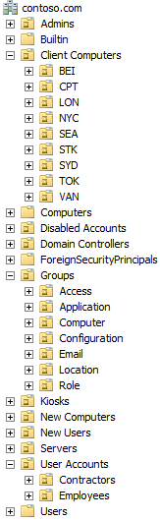
What Are OUs (Organisational Units)?
Containers that can be used to group objects within a domain
Create OUs to:
  Configure objects by assigning GPOs
  Delegate administrative permissions
OUs are represented by a folder with a book on it
Containers are represented by a blank folder
Notes:
Clearly establish for students the difference between OUs and containers: explain that containers are not OUs. Although containers can hold objects, they cannot have Group Policy Objects (GPOs) linked to them. Therefore, if you want to assign a GPO to an object, other than Domain level GPOs, it must be in an OU.
Be sure to point out the visual difference between an OU and a container: OUs are represented by a folder with a book on it, and containers are represented by a blank folder.
Explain to students that objects become orphaned most likely when an administrator on one domain controller deletes a container object, typically an OU, and an administrator on a different domain controller creates a child object, such as a user, in that container before the deletion has been replicated.
Remind students that the OU structure usually does not match the organizational chart, but is designed to support the delegation of administration, and should be a framework to support GPO linking. In a large organization, one with 50,000 users and computers, for example, it is much more manageable to divide those objects into OUs instead of trying to manage them in one very large unit.
Discuss some of the criteria that might drive the OU structure design, such as geographical location, department, object type, and cost center.
20410D
2: Introduction to Active Directory Domain Services

Slide 5





What Is an AD DS Forest?
Forest root
domain
Tree root
domain
adatum.com
fabrikam.com
atl.adatum.com
Child domain
Notes:
Use this slide to explain the relationships among the forest root domain, a child domain, and another tree. Emphasize that there is no administrative difference between the child domain and another tree, apart from the names.
20410D
2: Introduction to Active Directory Domain Services

Slide 6
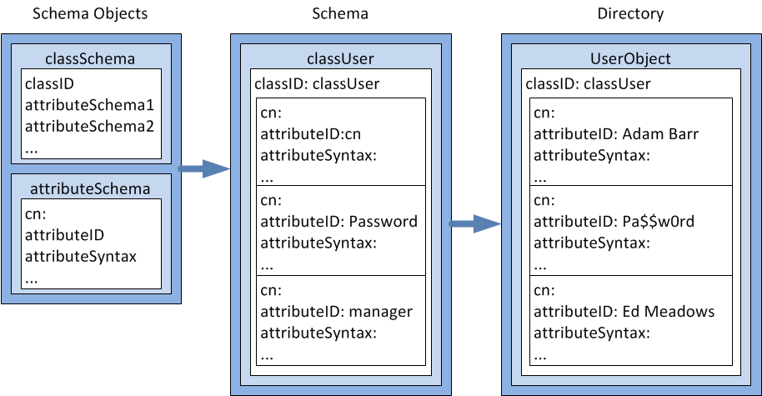
What Is the AD DS Schema?
The schema defines the objects that can be stored in AD DS
Notes:
Reinforce the concept that the schema defines the rules and syntax of the AD DS database, and provides the blueprint for the objects within it.
Optionally, you can demonstrate the Active Directory Schema snap-in to show how the objects are defined from attributes.
You also can show the hierarchy of objects and the inherited attributes. For example, the parent object for User is Organizational Person, the parent object for Organizational Person is Person, and the parent object for Person is an object called Top.
Point out that attributes are defined at each level in the hierarchy. This means that the User object contains all of the attributes that are defined on the User class, and all of the attributes defined farther up the objects hierarchy (Organizational Person, Person, Top).
20410D
2: Introduction to Active Directory Domain Services

Slide 7
What Is a Domain Controller?
Domain controllers
Servers that host the AD DS database (Ntds.dit) and SYSVOL
Kerberos authentication service and KDC services perform authentication
Best practices:
  Availability:
  At least two domain controllers in a domain
  Security:
  RODC and BitLocker
Notes:
Emphasize that the database and services are stored on servers called domain controllers.
Domain controllers—servers that perform the AD DS role—host the Active Directory database, SYSVOL, the Kerberos authentication service, and other Active Directory services. For redundancy purposes, it is best to have at least two available domain controllers.
Highlight that all domain controllers in a domain essentially are equal. Each domain controller contains a copy of the directory store, and updates can be made to the AD DS data on all domain controllers except for RODCs.
Emphasize the importance of having multiple domain controllers in each domain. This provides load balancing, but more importantly, it also provides recoverability if a server failure occurs.
Mention that all domain controllers engage in authentication and authorization, therefore the system has redundancy, with fewer fail points.
This topic does not provide much information about best practices. If students are interested, you can go into more detail about installing domain controllers in remote sites to protect against an unavailable wide area network (WAN) connection. You also can talk about increasing the number of domain controllers to account for redundancy and performance.
20410D
2: Introduction to Active Directory Domain Services

Slide 8





What Is the Global Catalog?
The global catalog:
  Hosts a partial attribute set for other domains in the forest
  Supports queries for objects throughout the forest
Schema
Configuration
Domain A
Schema
Configuration
Domain A
Schema
Domain B
Configuration
Global catalog server
Domain B
Schema
Configuration
Domain B
AD DS
Notes:
Describe the role of the global catalog server when searching for objects across domains in a forest. Define a global catalog as a domain controller that replicates the partial attribute set for each domain in the forest. The domain controller does not need the partial attribute set for its own domain because it already has the full copy of the domain database, and needs only the changes made to other domains. That is why, in a single-domain environment, making every domain controller a global catalog server adds no significant replication.
Question
Should a domain controller be a global catalog?
Answer
Global catalog placement affects how long a user’s sign-in takes. Therefore, global catalog placement must be planned carefully. In a single-domain environment, every domain controller should host the global catalog because every domain controller already holds a complete copy of the domain. In a multi‑domain scenario, you need to consider user sign-in times, program dependencies, global catalog high availability, and replication traffic when planning global catalog placement.
20410D
2: Introduction to Active Directory Domain Services

Slide 9


The AD DS Sign-in Process
The AD DS sign-in process:
The user account is authenticated to the domain controller.
The domain controller returns a TGT back to client.
The client uses TGT to apply for access to the workstation.
The domain controller grants access to the workstation.
The client uses TGT to apply for access to the server.
The domain controller returns access to the server.
Domain controller
Workstation
Server
Notes:
Use this slide to illustrate how the sign‑in process works.
In the first phase, the user account is authenticated to the domain controller.
In the second phase, the user account applies to the domain controller for a ticket to gain authorization to connect with the local computer.
A centralized directory service such as AD DS provides a single identity store, authentication service, and point of management for administration.
Emphasize the advantages of a single identity store for security and manageability.
Review the following information to prepare for this topic:
Security Identifiers Technical Reference:
http://go.microsoft.com/fwlink/?LinkID=331090
Well-known security identifiers in Windows operating systems:
http://go.microsoft.com/fwlink/?LinkID=331085
20410D
2: Introduction to Active Directory Domain Services

Slide 10
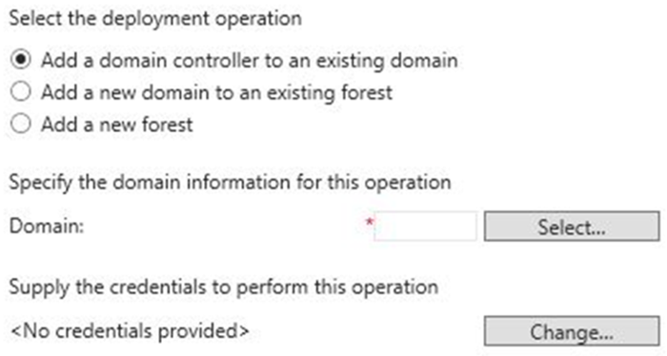
Installing a Domain Controller from Server Manager
Deployment Configuration section of the
Active Directory Domain Services Configuration Wizard
Notes:
Use Server Manager to describe the initial process of installing an AD DS domain controller. Explain that the Active Directory Domain Services Installation Wizard has been depreciated. However, you still can run the command, dcpromo, with an answer file and that this functionality was retained to allow companies that use automation to convert to Windows PowerShell deployments. Explain that the initial pass installs the files for AD DS, and then you can continue to configure the AD DS installation.
20410D
2: Introduction to Active Directory Domain Services

Slide 11
Installing a Domain Controller on a Server Core Installation of Windows Server
Installing AD DS is a two-step process regardless of which installation method you use
Method 1, use Server Manager on a Windows 2012 server with a GUI interface to connect to the system
  Install the files by installing the
    Active Directory Domain Services role
  Install the domain controller role by running the
  Active Directory Domain Services Configuration Wizard
Method 2, Use Windows PowerShell locally, or remotely using WinRM
  Install the files by running the command
  Install-WindowsFeature AD-Domain-Services
  Install the domain controller role by running the command Install-ADDSDomainController
Notes:
Explain the supported methods for installing the domain controller role on Windows Server 2012 servers remotely.
Refer to the links on the following web page to prepare for this topic:
AD DS Deployment Cmdlets in Windows PowerShell, at http://go.microsoft.com/fwlink/?LinkID=331089
20410D
2: Introduction to Active Directory Domain Services

Slide 12



AD DS Administration Tools
To manage AD DS objects, you can use the following graphical tools:
Active Directory Administration snap-ins
Active Directory Administrative Center
You can also use the following command-line tools:
Active Directory module in Windows PowerShell
Directory Service commands
C:/
Notes:
Consider demonstrating each tool as you discuss it.
20410D
3: Managing Active Directory Domain Services Objects

Slide 13
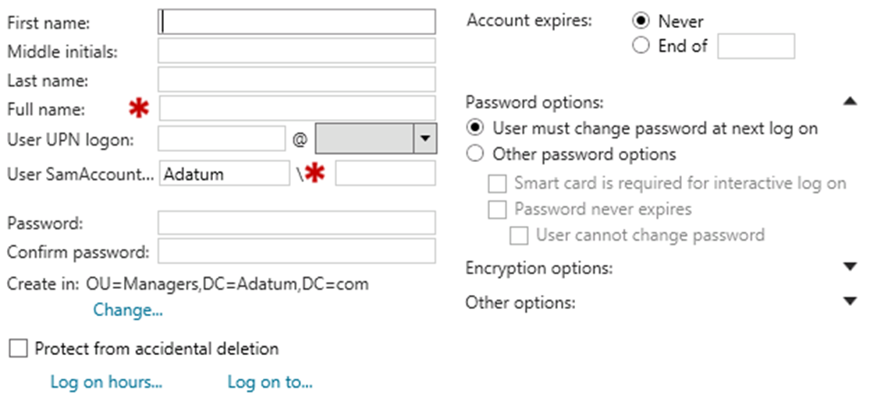
Creating User Accounts
The Account section of the Active Directory Administrative Center Create User window
Notes:
Consider performing a demonstration of creating a user account, by using the steps that the student handbook provides.
Discussion Prompt
Ask your students about their user account naming strategies.
20410D
3: Managing Active Directory Domain Services Objects

Slide 14
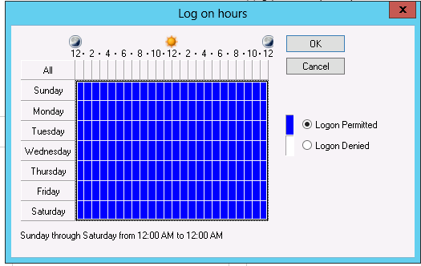
Configuring User Account Attributes
The Log on hours dialog box
Notes:
Consider opening users’ accounts and viewing their account properties as you discuss this content with students.
20410D
3: Managing Active Directory Domain Services Objects

Slide 15




Group Types
Distribution groups
  Used only with email applications
  Not security-enabled (no SID); cannot be given permissions
Security groups
  Security principal with a SID;
  can be given permissions
  Can also be email-enabled
  Both security groups and distribution groups can be converted to the other type of group
Notes:
Explain to students that they can use distribution groups to send email messages to collections of users, but only with messaging programs such as Microsoft Exchange Server. Stress that distribution lists are not security-enabled, so they cannot be listed in discretionary access control lists (DACLs).
Also explain to students that they can use security groups to assign rights and permissions to both groups of users and groups of computers. A security group is security-enabled, and you can use it to assign permissions to local and network resources.
20410D
3: Managing Active Directory Domain Services Objects

Slide 16
Group Scopes
Group scope | Members from same domain | Members from domain in same forest | Members from trusted external domain | Can be assigned permissions to resources
Local | U, C, GG, DLG, UG and local users | U, C, GG, UG | U, C, GG | On the local computer only
Domain-local | U, C, GG, DLG, UG | U, C, GG, UG | U, C, GG | Anywhere in the domain
Universal | U, C, GG, UG | U, C, GG, UG | N/A | Anywhere in the forest
Global | U, C, GG | N/A | N/A | Anywhere in the domain or a trusted domain
U User
C Computer
GG Global group
DLG Domain-local group
UG Universal group
Notes:
Use the table to describe group scopes. Consider drawing a diagram with several domains that shows where you can create groups, and the implications of each group scope.
20410D
3: Managing Active Directory Domain Services Objects

Slide 17





Implementing Group Management
I
Identities
Users or computers,
which are members of
Global groups
Which collect members based on members’ roles,
which are members of
Sales
(Global group)
G
Auditors
(Global group)
ACL_Sales_Read
(Domain-local group)
DL
Domain-local groups
Which provide management
such as resource access,
which are
A
Assigned access to a resource
This best practice for nesting groups is known as IGDLA.
Notes:
This slide and the next five explain the example in the student notes. This slide summarizes the example, and the next five slides build up the example frame by frame. The five frames are:
Identities
Global groups
Domain-local groups
Assigned resource access
A copy of the summary, as shown in the first slide above
Alternatively, draw an illustration on the whiteboard by using the following guidelines to illustrate the advantage of group nesting:
Draw three domain objects, each containing five users. Draw a file object in one of the three domains.
Question: How many file permissions do you need to create to assign permissions on this file for each user?
Answer: You need to create 15 file permissions.
Draw a circle around the five users in each domain, and explain that the circles represent global groups.
Question: How many permissions on the file do you need to assign at the global group level?
Answer: You need to assign three permissions.
Draw a circle adjacent to the file. Draw arrows from your global groups to this circle, indicating that you have added these groups to a local group in the resource holding domain.
Question: How many permissions must you assign to the local group?
Answer: You must assign one permission to the local group.
20410D
3: Managing Active Directory Domain Services Objects

Slide 18
Implementing Group Management
I
Identities
Users or computers,
which are members of
Notes:
This is the 1st of 5 frames.
Identities are assigned to users or groups.
20410D
3: Managing Active Directory Domain Services Objects

Slide 19
Implementing Group Management
I
Identities
Users or computers,
which are members of
Global groups
Which collect members based on members’ roles,
which are members of
Sales
(Global group)
G
Auditors
(Global group)
Notes:
This is the 2nd of 5 frames.
The users and computers have been collected into two separate groups, the Sales (global group) and the Auditors (global group).
20410D
3: Managing Active Directory Domain Services Objects

Slide 20
Implementing Group Management
I
Identities
Users or computers,
which are members of
G
Global groups
Which collect members based on members’ roles,
which are members of
Sales
(Global group)
Auditors
(Global group)
ACL_Sales_Read
(Domain-local group)
DL
Domain-local groups
Which provide management
such as resource access,
which are
Notes:
This is the 3rd of 5 frames.
The two global groups have been combined into one domain local group, which is called ACL_Sales_Read.
20410D
3: Managing Active Directory Domain Services Objects

Slide 21
Implementing Group Management
I
Identities
Users or computers,
which are members of
G
Sales
(Global group)
Global groups
Which collect members based on members’ roles,
which are members of
Auditors
(Global group)
ACL_Sales_Read
(Domain-local group)
DL
Domain-local groups
Which provide management
such as resource access,
which are
A
Assigned access to a resource
Notes:
This is the 4th of 5 frames.
The domain-local group has been given access to a resource.
20410D
3: Managing Active Directory Domain Services Objects

Slide 22
Implementing Group Management
I
Identities
Users or computers,
which are members of
G
Sales
(Global group)
Global groups
Which collect members based on members’ roles,
which are members of
Auditors
(Global group)
ACL_Sales_Read
(Domain-local group)
DL
Domain-local groups
Which provide management
such as resource access,
which are
A
Assigned access to a resource
This best practice for nesting groups is known as IGDLA
Notes:
This is the 5th of 5 frames.
This is a summary of the example. It is the same as the slide in the Student Manual.
20410D
3: Managing Active Directory Domain Services Objects

Slide 23
Default Groups
Carefully manage the default groups that provide administrative privileges, because these groups:
  Typically have broader privileges than are necessary for most delegated environments
  Often apply protection to their members
Group | Location
Enterprise Admins | Users container of the forest root domain
Schema Admins | Users container of the forest root domain
Administrators | Built-in container of each domain
Domain Admins | Users container of each domain
Server Operators | Built-in container of each domain
Account Operators | Built-in container of each domain
Backup Operators | Built-in container of each domain
Print Operators | Built-in container of each domain
Cert Publishers | Users container of each domain
Notes:
Show your students the groups mentioned on the slide as you discuss them.
20410D
3: Managing Active Directory Domain Services Objects

Slide 24
Special Identities
Special identities:
  Are groups for which membership is controlled by the operating system
  Can be used by the Windows Server operating system to provide access to resources:
    Based on the type of authentication or connection
    Not based on the user account
Important special identities include:
Anonymous Logon Authenticated Users Everyone | Interactive Network Creator Owner
Notes:
Show your students the identities that are mentioned on the slide, as you discuss them.
20410D
3: Managing Active Directory Domain Services Objects

Slide 25
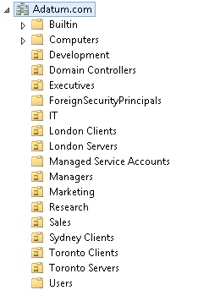
Considerations for Using Organizational Units
OUs allow you to subdivide the domain for management purposes
OUs are used for:
  Delegation of control
  Application of GPOs
The OU structure can be:
  Flat, one to two levels deep
  Deep, more than 5 levels deep
  Narrow, anything in between
Notes:
Discuss the design of an organizational unit (OU) hierarchy. Discuss your experience with OU design, and students’ environments and the reasons they have created OUs. Explain that you should create OUs with a specific management goal in mind, with ease of management as a goal.
20410D
3: Managing Active Directory Domain Services Objects

